Slide 1
Bayesian Inference
Module 2, Lesson 1
Notes:
Welcome to lesson 1 of module 2 of bayesian inference

Slide 2
Binomial and Posterior Distributions
Shahrzad Jamshidi, PhD
Notes:
In this lesson, we will discuss binomial and posterior distributions

Slide 3
Last Time
The general ideas of Bayesian treatments
Computational considerations
Notes:
In the last lesson, we discussed general ideas of Bayesian statistics as well as computational considerations.

Slide 4
Objectives
Estimate probabilities from binomial data.
Understand the posterior distribution as a compromise between data and prior information.
Summarize and interpret posterior distributions.
Notes:
By the end of this lesson, you should be able to
(1) Estimate probabilities from binomial data,
(2) Understand the posterior distribution as a compromise between data and prior information.
(3) Summarize and interpret posterior distributions.

Slide 5
What to Review for this Lecture
Choose function
Chain rule for joint probabilities
Gamma function
Beta distribution
Notes:
Some topics I recommend reviewing for this lecture include
The Choose function
The Chain rule for joint probabilities
The Gamma function
The Beta distribution

Slide 6

Bernoulli trials
Aim: to estimate an unknown population proportion from the results of a sequence of binary data
Binary data is data with two possible outcomes that can be encoded as 0 or 1
These results are called Bernoulli trials.
Such trials can often be modeled with a binomial distribution.
iStock-1648369465 Credit - Rudzhan Nagiev
Notes:
Suppose we wish to estimate an unknown proportion in a population for which there are only two potions. This could be, for example, the percentage of people who will vote ”yes” on a proposition.
Notice that the data is binary in this aim. We have two possible outcomes, which can be labeled “1” (say for yes) and “0” (say for no).
These are called Bernoulli trials, which are random experiments with exactly two possible outcomes: success or failure.
This type of data is modeled with a binomial distribution.

Slide 7
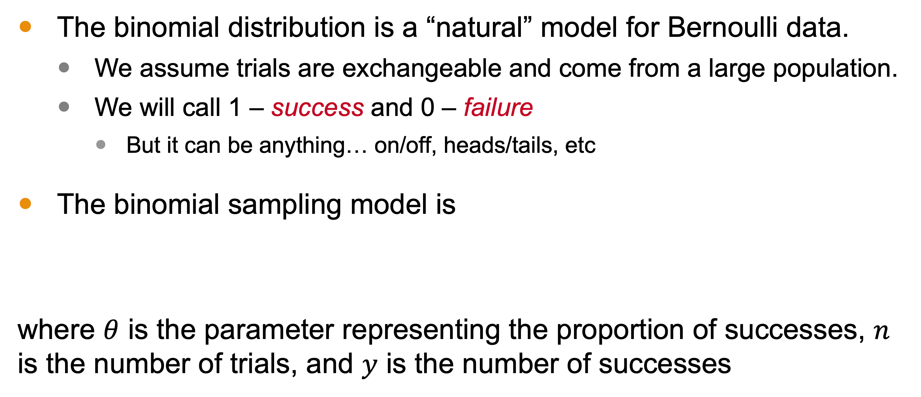
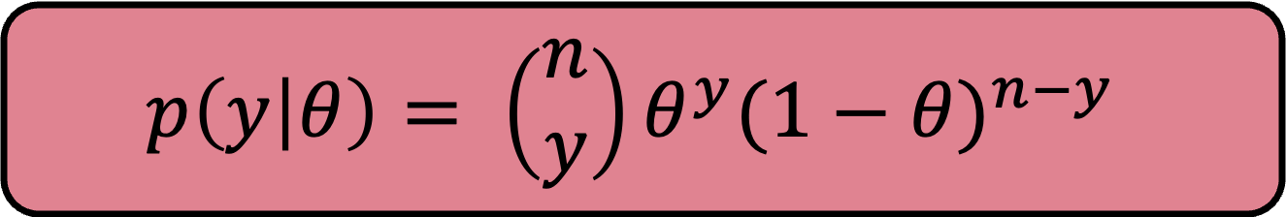
Binomial Distribution
The binomial distribution is a “natural” model for Bernoulli data.
We assume trials are exchangeable and come from a large population.
We will call 1 – success and 0 – failure
But it can be anything… on/off, heads/tails, etc
The binomial sampling model is
where $θ$ is the parameter representing the proportion of successes, $n$ is the number of trials, and $y$ is the number of successes
$$p\left(y | θ\right)= \left(\begin{matrix}n \\ y\end{matrix}\right)θ^{y}{(1−θ)}^{n−y}$$
Notes:
The binomial distribution is thought of as the natural way to model Bernoulli data
We assume these are exchangeable trials. In our voting example, that means our population estimate isn’t effected by the order in which votes are collected.
We can call 1 success and 0 for failure.
This can be anything, including on/off switchs, heads/tails flips, yes/no votes
Here is the equation of the model, where y is the number of successes in n trials, and theta is the parameter representing the expected likelihood of each trial being a success.
To help us remember these concepts a little better, let’s see an example.

Slide 8
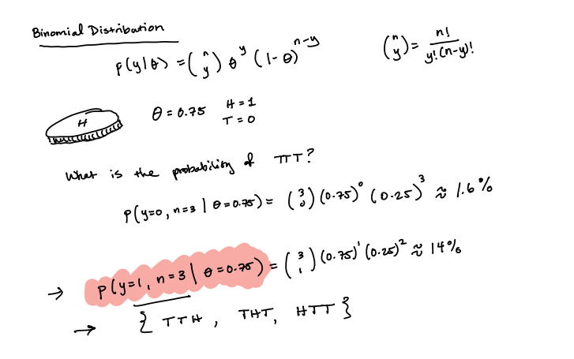
Notes:
M2L11BinomialExample

Slide 9
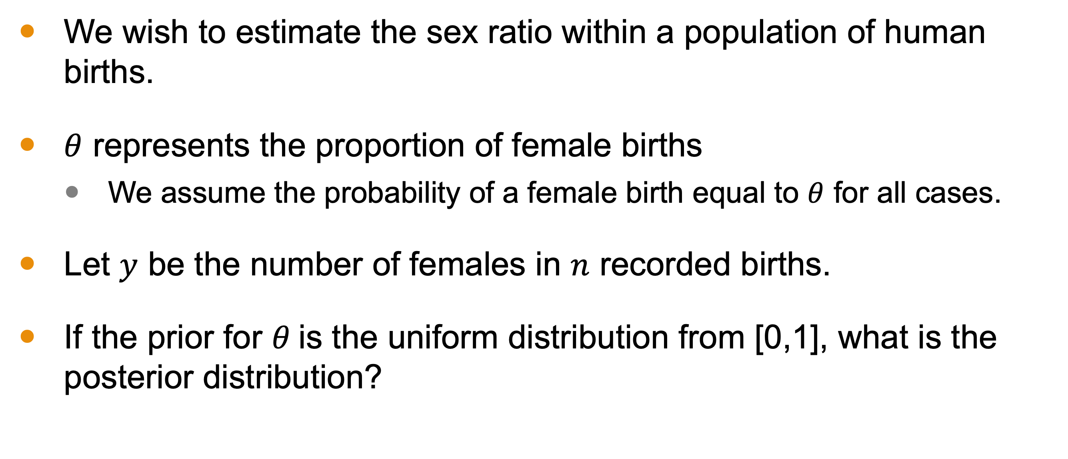
Example: Estimating Female Birth
We wish to estimate the sex ratio within a population of human births.
$θ$ represents the proportion of female births
We assume the probability of a female birth equal to $θ$ for all cases.
Let $y$ be the number of females in $n$ recorded births.
If the prior for $θ$is the uniform distribution from [0,1], what is the posterior distribution?
Notes:
In this class, we are interested in building a posterior distribution, which is used as a model for our actual population.
Let’s see what this looks like with an example. Here, we assume we are trying to estimate theta, the proportion of female births in a population. (1-theta) is the estimate for nonfemale births.
Let y be the number of females in n births. Notice that we will be doing this work without specifying values.
If the prior is the uniform distribution, what is the posterior?

Slide 10
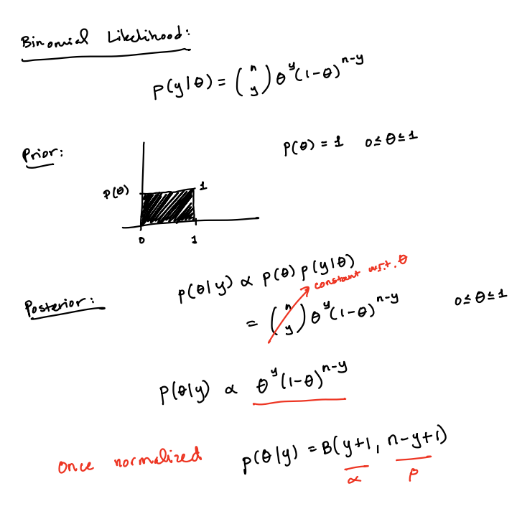
Notes:
M2L12BinomialPosterior

Slide 11
Distribution
Notes:
Here are the distributions assuming n is 15 and y is changing. The blue line represents the mode and the red line represents the mean.

Slide 12
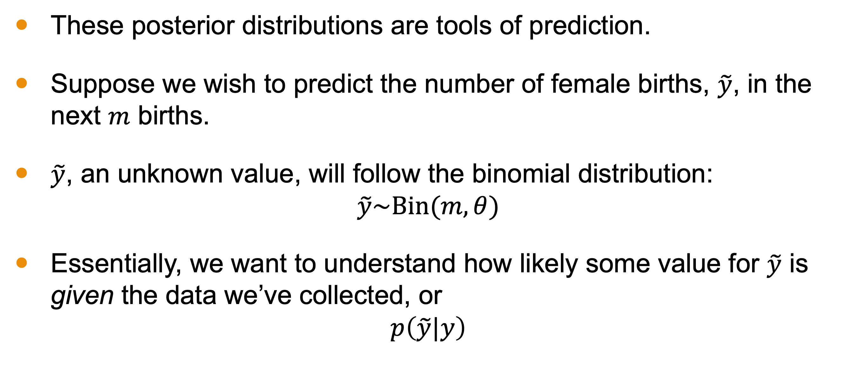
Prediction
These posterior distributions are tools of prediction.
Suppose we wish to predict the number of female births, $\tilde{y}$, in the next $m$ births.
$\tilde{y}$, an unknown value, will follow the binomial distribution:
$$\tilde{y}\sim \text{Bin}(m,θ)$$
Essentially, we want to understand how likely some value for $\tilde{y}$ is given the data we’ve collected, or
$$p\left(\tilde{y}|y\right)$$
Notes:
As I said earlier, it is the posterior distributions we aim to construct. Why? Because these are our models of the population and what we use to make predictions.
So suppose we wish to do that with some value of y tilde with the next m births.
Because this is a Bernoulli trial, we know this should be modeled with a binomial distribution with some parameter theta. But this parameter value is what is modeled with a our posterior. For every value of theta, our posterior distribution gives us an estimated probability of that value. What I want to do is consider each of those thetas, with their assumed probability from my posterior and use ALL of them to estimate how likely y-tilde is in the next m trials.
In other words, I really want to know the probability of y-tilde given y, the data I observed to compute my posterior. So let’s compute this.

Slide 13
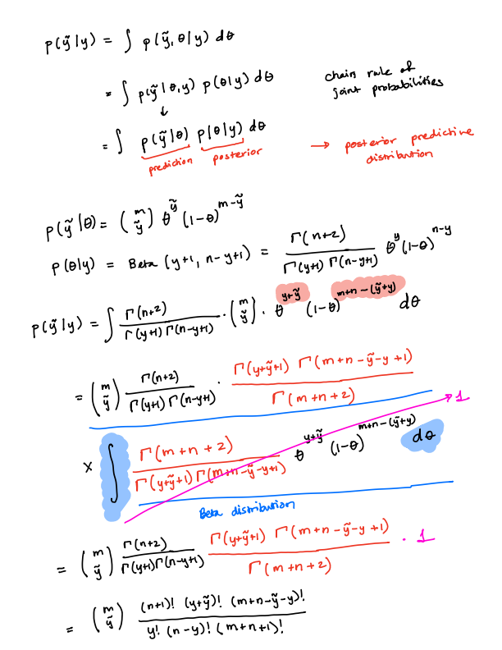
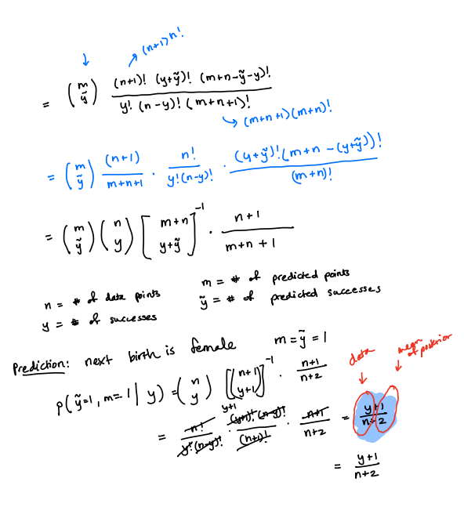

Slide 14

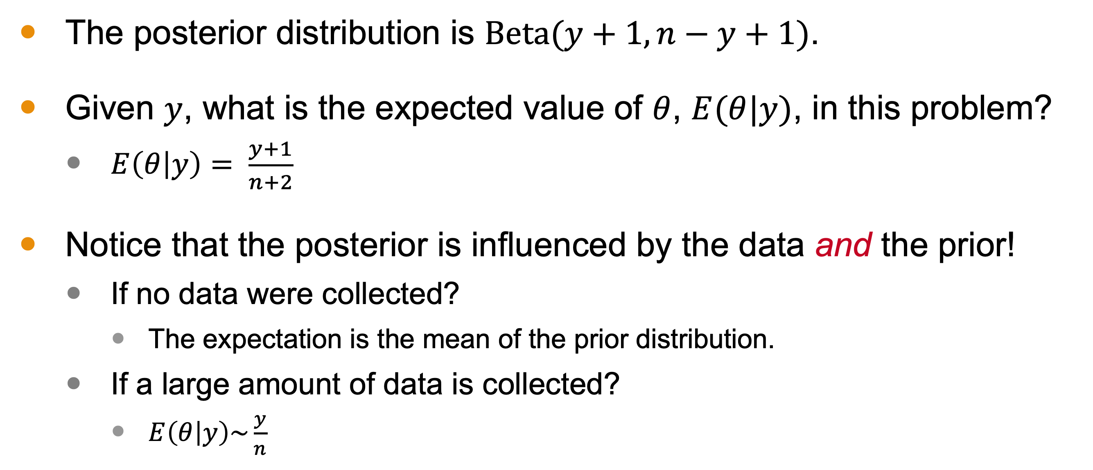
Influence of Data and Prior on $θ$ in Example
The posterior distribution is $\text{Beta}(y+1, n−y+1)$.
Given $y$, what is the expected value of $θ$, $E(θ|y)$, in this problem?
$E\left(θ | y\right)= \frac{y+1}{n+2}$
Notice that the posterior is influenced by the data and the prior!
If no data were collected?
The expectation is the mean of the prior distribution.
If a large amount of data is collected?
$E\left(θ | y\right)\sim \frac{y}{n}$
Notes:
Now, let’s notice that our posterior distribution—the key product in problems like this--is a balance between the data and the prior.
In our binomial distribution example, we had a posterior distribution of "Beta"(𝑦+1, 𝑛−𝑦+1).
Given 𝑦, what is the expected value of 𝜃, 𝐸(𝜃|𝑦), in this problem?
We take the average of the Beta distribution and get y+1 / n+2
Notice that the posterior is influenced by the data and the prior! Our prior is the uniform distribution with a mean of ½. You can see that in our quotient.
If no data were collected, meaning y=n=0, then
We would get exactly that prior distribution’s mean
If a large amount of data were collected, like in the millions,
Then the impact of that +1 in the numerator and +2 in the demoninator would be negligible. So we would be looking at a posterioer entirely influenced by the data.

Slide 15
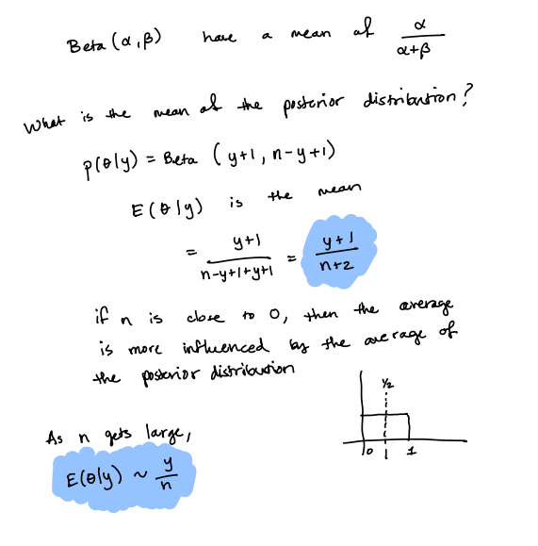

Slide 16
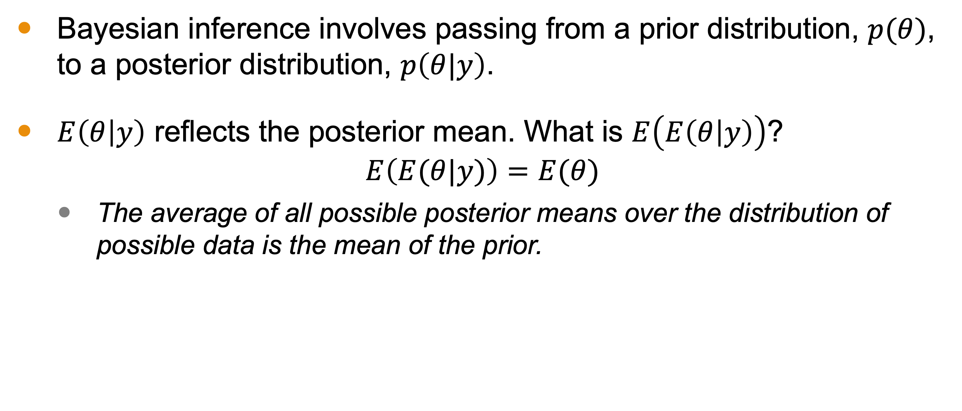
Posterior’s Mean, in General
Bayesian inference involves passing from a prior distribution, $p(θ)$, to a posterior distribution, $p\left(θ|y\right)$.
$E\left(θ | y\right)$ reflects the posterior mean. What is $E\left(E\left(θ | y\right)\right)$?
$$E\left(E(θ|y)\right)=E(θ)$$
The average of all possible posterior means over the distribution of possible data is the mean of the prior.
Notes:
At its heart, Bayesian inference involves passing from a prior distribution, $p(θ)$, to a posterior distribution, $p\left(θ|y\right)$.
$E\left(θ | y\right)$ reflects the posterior mean. What is expectation of that posterior mean?
It is the average of all possible posterior means over the distribution of possible data—this is the mean of the prior!

Slide 17
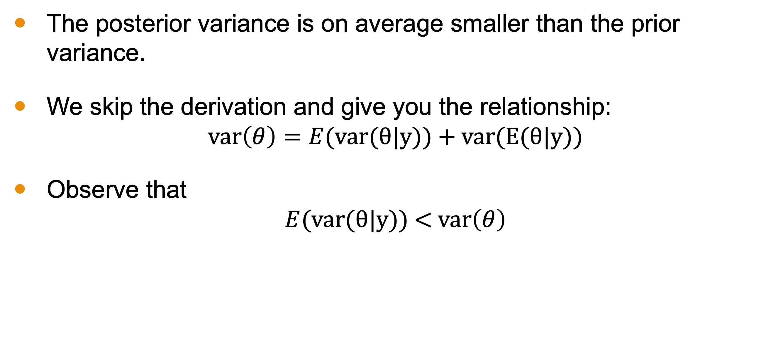
Posterior Variance
The posterior variance is on average smaller than the prior variance.
We skip the derivation and give you the relationship:
$$\text{var}\left(θ\right)=E(\text{var}\text{(}θ\text{|}\text{y}\text{)) + }\text{var}\text{(}\text{E}\text{(}θ\text{|}\text{y}\text{))}$$
Observe that
$$E(\text{var}\text{(}θ\text{|}\text{y}\text{))}\text{ < }\text{var}\left(θ\right)$$

Slide 18
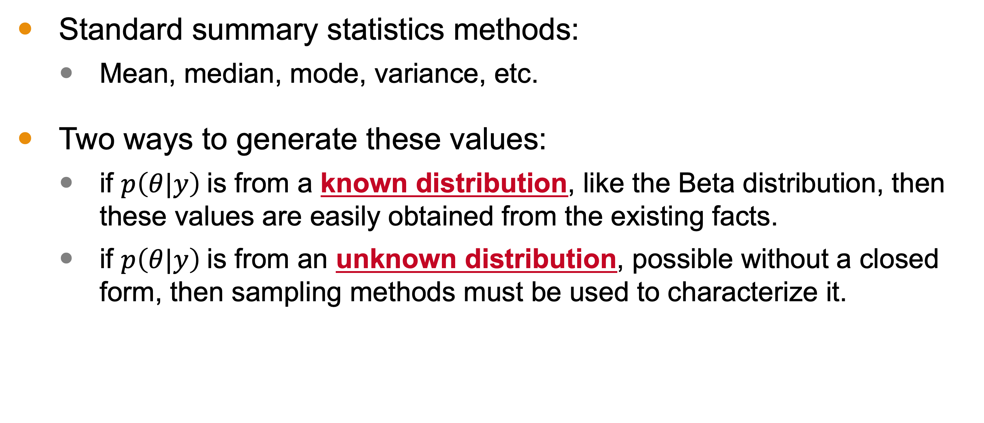
Summarizing Posterior Distribution
Standard summary statistics methods:
Mean, median, mode, variance, etc.
Two ways to generate these values:
if $p\left(θ|y\right)$is from a known distribution, like the Beta distribution, then these values are easily obtained from the existing facts.
if $p\left(θ|y\right)$is from an unknown distribution, possible without a closed form, then sampling methods must be used to characterize it.

Slide 19
Summary
We studied an example with the binomial distribution defining the likelihood.
The prior was a uniform distribution.
We computed the prior without specific values for our data.
Through this example, we saw
how prediction is computed.
how the prior and data influence the posterior.
We also discussed using sampling or known facts to summarize the posterior distribution.

